Slide 1



Introducing HPE's new multi-cloud management platform to accelerate your digital transformation
Robert McCaleb
Hybrid Cloud Chief Technologist

Slide 2
HPE Big Picture
Advisory-led
Consumption enabled
HPE OneSphere
Hybrid IT multi-cloud management
API
API
HPE OneView
Automation and composability
API
API
Infrastructure
Traditional infrastructure
Converged infrastructure
Hyperconverged infrastructure
Composable infrastructure

Slide 3

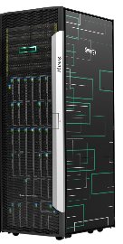
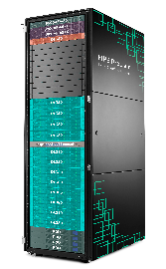
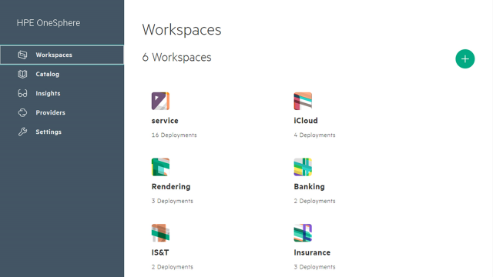
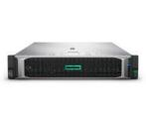
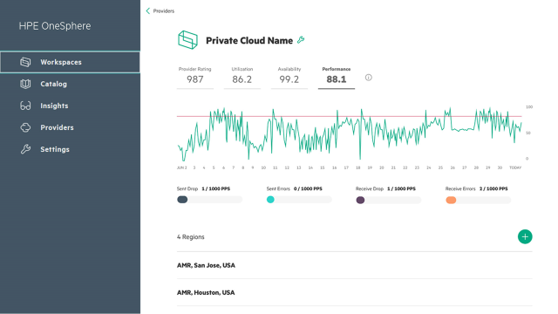
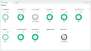
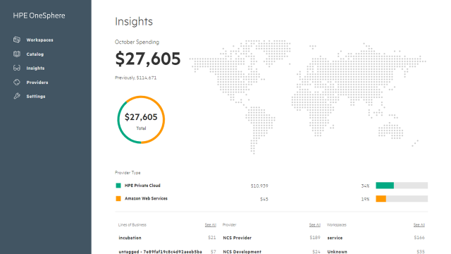
Building on our momentum to simplify Hybrid IT
Simplify on-premises
Simplify multi-cloud
HPE Software-Defined
HPE Multi-Cloud Management
API
Turn infrastructure into software-defined
Compose workloads
Simplify VM environments
Deliver Microsoft Azure Services on-premises
HPE OneView 900K+ licenses
HPE Synergy 1000+ customers
HPE SimpliVity 4x market growth
HPE ProLiant for Microsoft Azure Stack Now shipping
OneView
OneSphere
API
Notes:
In response, we've been working to make hybrid IT simple
To solve the complexities and accelerate Digital transformation
We are simplifying both on-premises private and multi cloud
To simplify on-premises we are innovating: SDI to bring cloud model to your data center
HPE ProLiant for Microsoft Azure Stack = Industries leading scalable Azure solution
SimpliVity = (simple VM vending) Simplify your virtualizes apps and data
Synergy = (on prem IAAS) Enable you to compose all your workloads and workflows
O/V = Transforms your infrastructure in SDI
But that’s not enough…you asked to simplify your multi-cloud world…
Access all clouds with a unified cloud resource pool
Enable you to build on-premises clouds faster
Streamline DevOps workflow to deliver apps faster (keep devs happy)
Provide insights on cost and utilization across clouds
I can’t wait to show you…
But let’s start with how we are simplifying on-premises

Slide 4
HPE OneSphere
Simplifies multi-cloud management so you can build clouds, develop apps and gain insights faster
Introducing
Notes:
Customers want to engage with businesses in a digital way. Organizations want to innovate and transform to create competitive differentiation and advantage, which might entail digitizing the customer experience. The result is a greater reliance on digital systems and processes, and an explosion of applications and data.
IT is powering this digital transformation and has adopted a hybrid strategy (Multiple public and private clouds and on-premises infrastructure). While that has brought some efficiencies, it’s also created management complexity.
That’s where HPE OneSphere comes in.
It’s a multi-cloud management platform that unifies the management of on- and off-premises resources and enables seamless deployment, operation, and optimization of multi-cloud environments and applications. It helps you manage digital services/workloads across the hybrid estate from a single point, delivering the speed, simplicity and greater cost efficiency.
HPE OneSphere is a singular solution that consists of a management experience delivered as a service, API-driven resources via on-premises software-defined infrastructure and public cloud, and Pointnext services to enable low touch lifecycle management. With HPE OneSphere you can deploy applications quickly, optimizing the right mix of on- and off-premises resources. Your developers get their workspace; a rich library of app and infrastructure templates, APIs, and a choice of multiple public and private clouds; and the ability to self-service provisioning and deployment. Dashboard reporting provides utilization and cost insights and analytics across an entire hybrid IT estate, giving you—and your LOB counterparts—the ability to deploy workloads based on business and economic requirements and making it easier to tap into underutilized resources already on-premises.
Velocity/speed – on-premises or public clouds, containers, and VMs can be stood up in minutes, and self-service provisioning accelerates test/dev and production deployment – speeding release frequency.
Productivity is top-of-mind with the product’s self-service design, and customizable workspaces. Its ability to eliminate functional silos and streamline handshaking between development and IT operations and LOB is key. The “low ops” lifecycle management capabilities and other automation creates productivity for IT ops – which can facilitate a shift from operations-focused resources to application-focused resources.
And the solution is designed with end-to-end efficiency in mind, including visibility into resource usage across the hybrid environment to drive higher utilization and lower costs – improving ROI.

Slide 5
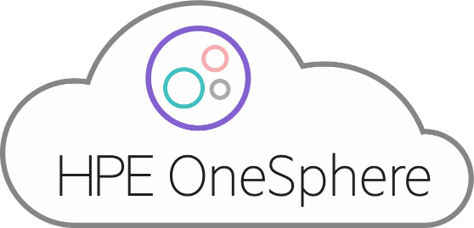
OneSphere Intent
Simplifies all your public clouds
AWS
Google
Azure
Cloud28+
Software as a service
Simplifies your on-premises
Private clouds, Azure Stack, VMs, containers and bare metal
Notes:
OneSphere is different from traditional Cloud Management tools:
It’s software-as-a-service platform – no SW or HW to install. AND, automatically integrates with our SDI (if)
It’s open to all clouds – AWS, Azure, Google, Cloud 28+ and private clouds
It enables customers to build and deliver clouds faster for all workload deployment models:
Including VMs, containers and bare metal

Slide 6

Enabling IT, LOB and Developers to work together faster
Developers
IT Ops
Self-service
Use the services they like
Work in any cloud
Easy access catalog
Enables rapid VM, container and bare metal vending
Intelligent scaling of infrastructure
Accelerate cycle time
More apps less ops
Increase ROI
CIO/Business
Costs and utilization insights across all clouds
Notes:
New Stack provides a unified experience, allowing:
DevOps to self-service and compose multi-cloud environments and apps on demand
Speed deployment (time to value)
Reduce the level of specialized cloud stack skills
IT operations to streamline productivity with a “low touch” operations model (Infrastructure provisioning and management automation)
IT staff can be redeployed to new, strategic, and business-facing tasks
Reallocation of operating expenses from operators to developers (“ops to apps”)
LOB executives to access multi-cloud resource utilization and cost metrics
Optimizing application deployment for business and economic demands

Slide 7
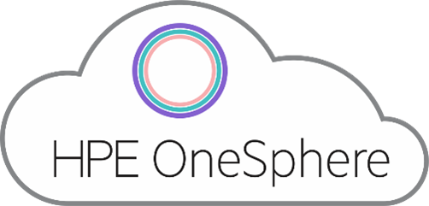

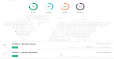
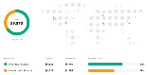

As a service portal for all stakeholders
Visibility across ALL your clouds (In one spot)
Private - Vmware (and AzureStack later)
Public - AWS, Azure (and GCP later)
Insights Analytics (Cost and Uptime/Availability)
Ready to Go Now - SaaS (no infrastructure needed)
From order to production in Hours (SaaS spin up)
Implementation in Minutes not Days/Weeks/Months
Little to no training required
Works with what you have (Non-Intrusive)
Don't Replace - ENHANCE (Bolt On/Enhances current tools/processes)
Devs and Power Users can stay using the THEIR tools of choice
Integration - API >> We have “An App” for that - not a script - done on GitHub – community
Developers
IT Operations
Business/CIO
Notes:
OneSphere is different from traditional Cloud Management tools:
It’s software-as-a-service platform – no SW or HW to install. AND, automatically integrates with our SDI (if)
It’s open to all clouds – AWS, Azure, Google, Cloud 28+ and private clouds
It enables customers to build and deliver clouds faster for all workload deployment models:
Including VMs, containers and bare metal

Slide 8

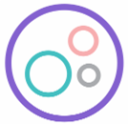

HPE OneSphere Overview
Simplify multi-cloud
Start up instantly via SaaS management
Build on-premises clouds and connect to public clouds in a few clicks
Immediately access to new public cloud services
Catalog of tools and cloud services
Orchestration and brokering
Metering and cost analytics
Security and multi-tenancy
Lifecycle management
Streamline DevOps workflow
Access all clouds with a unified cloud resource pool
Pic
Pic
Pic
Get real-time insights on cost and utilization across clouds
Optimize workload deployment
Multi-cloud/Multi-site virtual resource pool
Pic
Pic
Simplify on-premises
AWS
Google
Traditional and cloud
Bare Metal, VMWare, OpenStack, Containers
Pic
Speed resource vending
Cloud 28+
Azure
Automate infrastructure lifecycle management
Automate everything through APIs
API
Manual
Optimize on-premises utilization
Choose from consumption models to optimize costs
On-premises software-defined infrastructure
Traditional infrastructure

Slide 9
HPE OneSphere Demo
Carl Siemianowski
OneSphere Architect
Notes:
Today building a private cloud is complex and time consuming
Most customers say their virtualization cluster is their private cloud. It’s a great start for efficiency through virtualization…
But these virtualization clusters lack:
The ability for their admins and developers to deploy quickly (service portal)
Multi-tenancy
The ability to scale resources seamlessly
Multiple deployment models – like containers, bare metal
Let’s see this using OneSphere

Slide 10

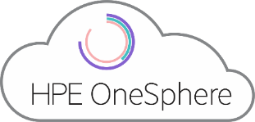
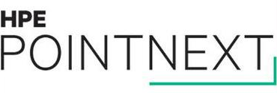
Only HPE helps you realize an end-to-end multi-cloud solution
Advise
Power
Consume
Cloud strategies and economics
Cloud governance and security
Application portfolio assessment
HPE OneSphere
Managed cloud controls
HPE OneSphere as a managed service
Pay-as-you-go consumption
Notes:
It’s not just a SaaS tool
OneSphere is supported by a full suite of advisory and consumption services from HPE Pointnext
We realize that customers are in different places in their cloud journey. CTP can advise customers on their digital transformation and hybrid journey
cloud strategy
Security and governance
Operate in a multi cloud world
And HPE Pointnext Flex Capacity turns on-premises into a pay-for-use consumption model

Slide 11
Thank you
HPE.com/OneSphere

